Slide 1


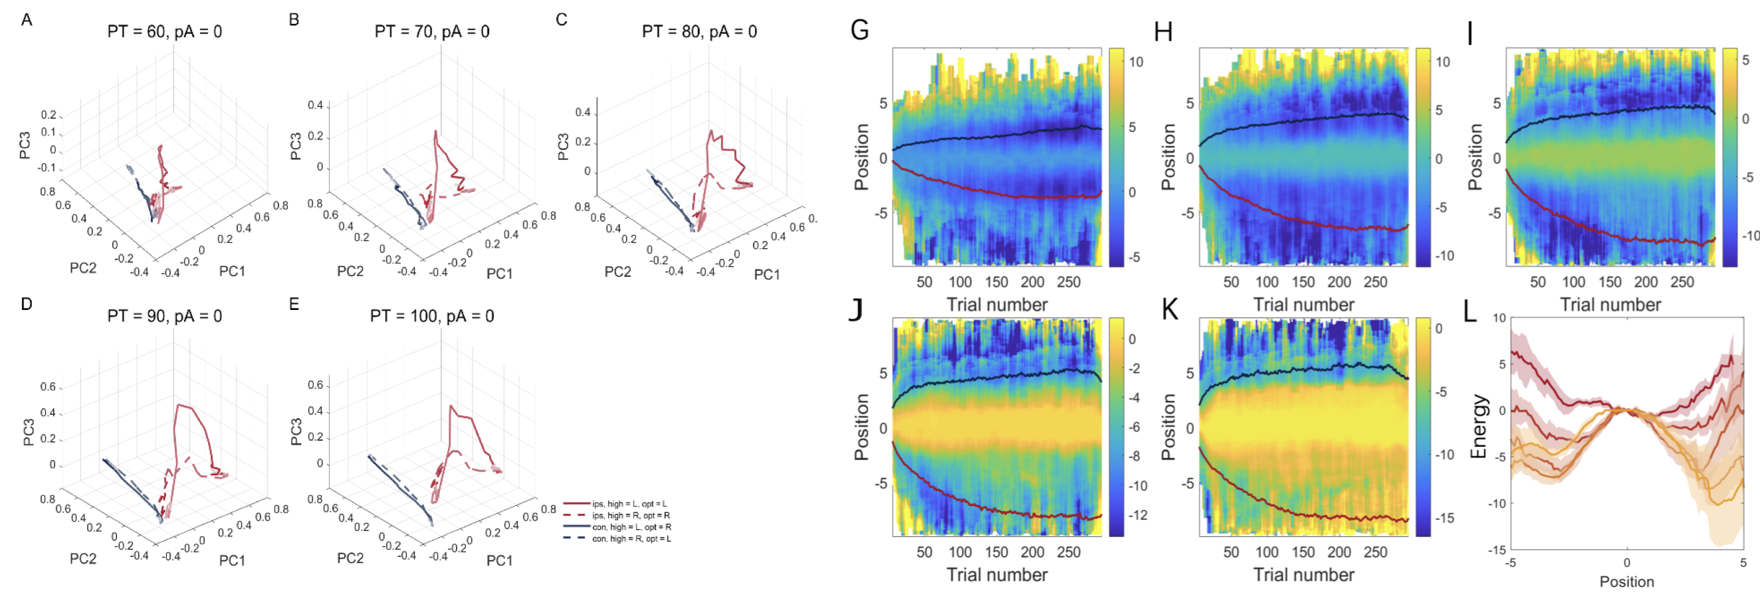
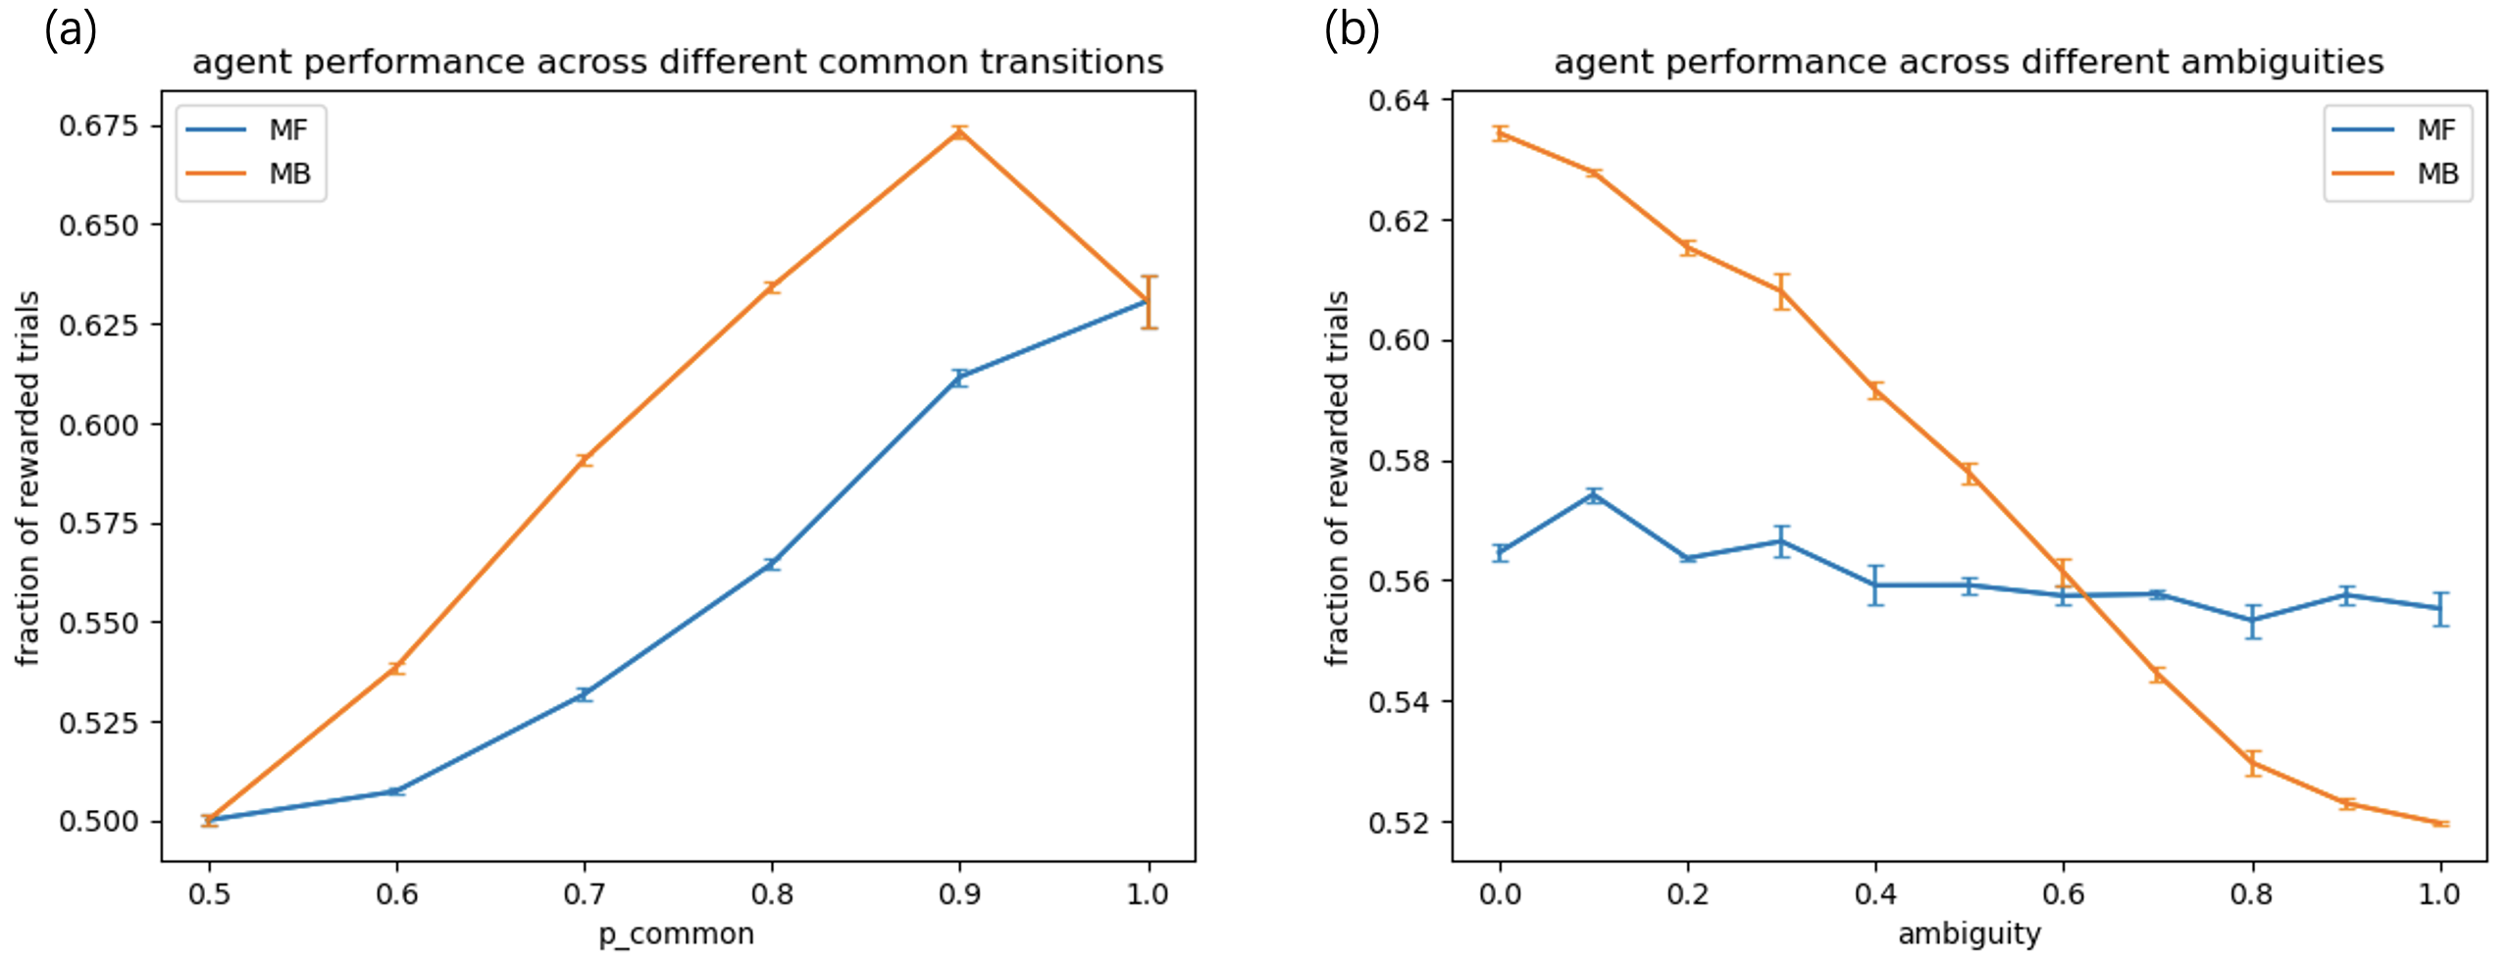
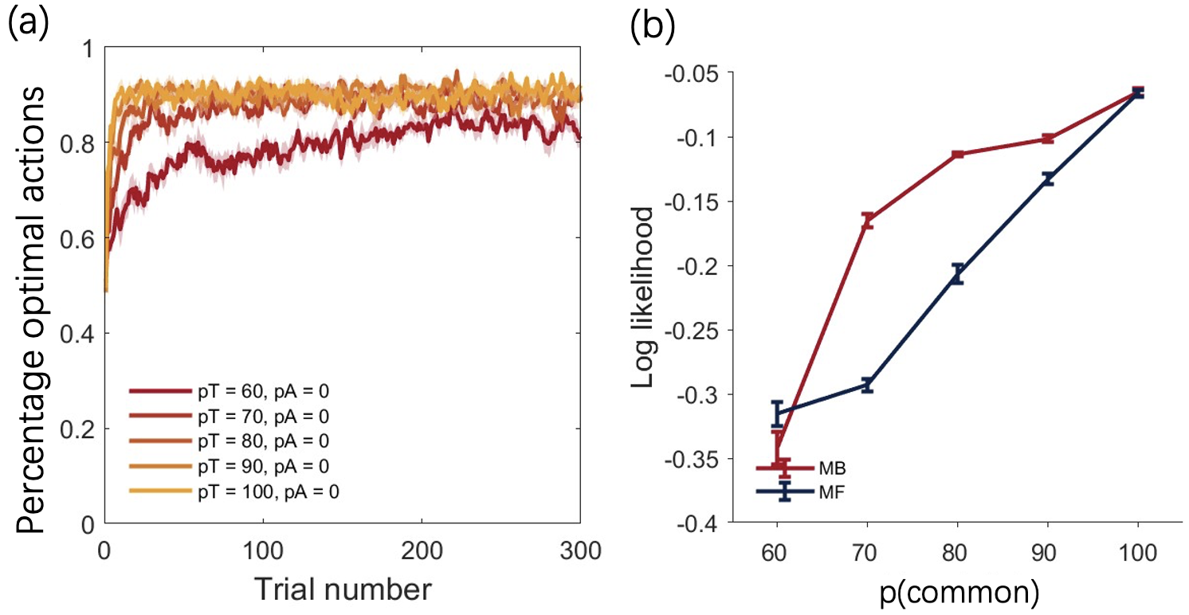
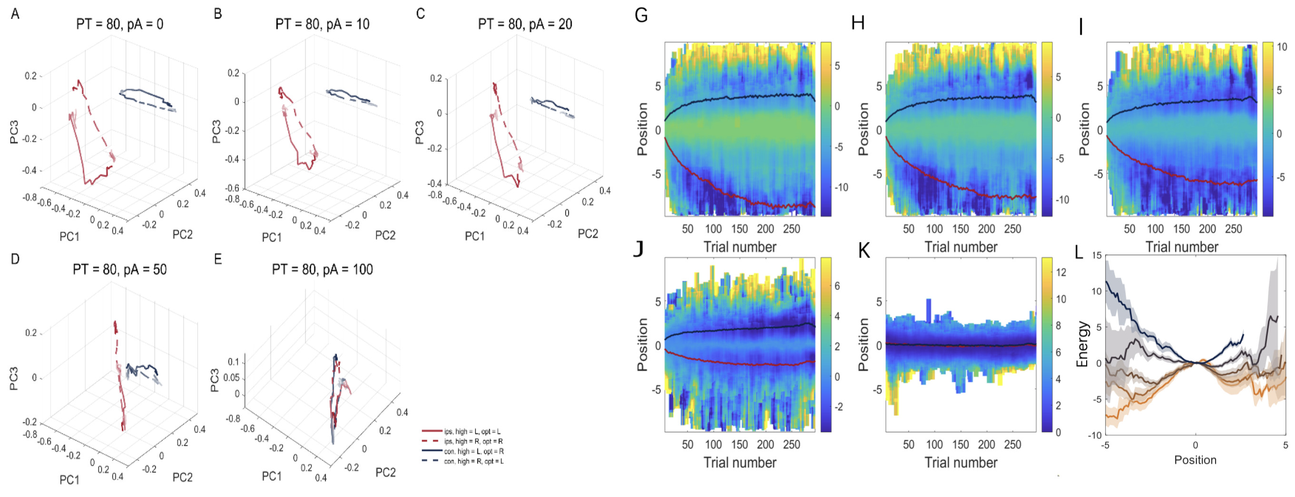
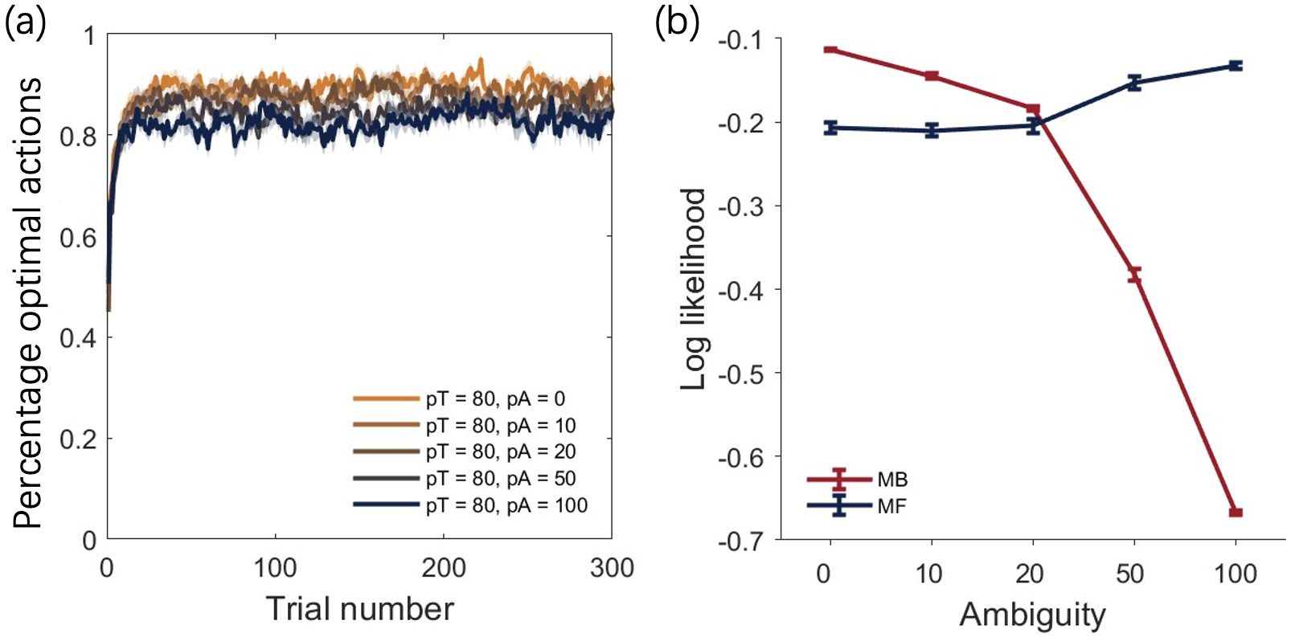
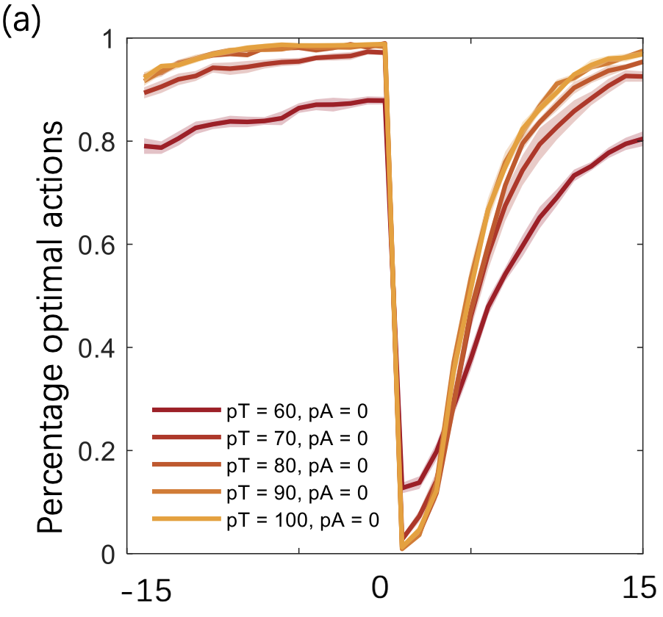
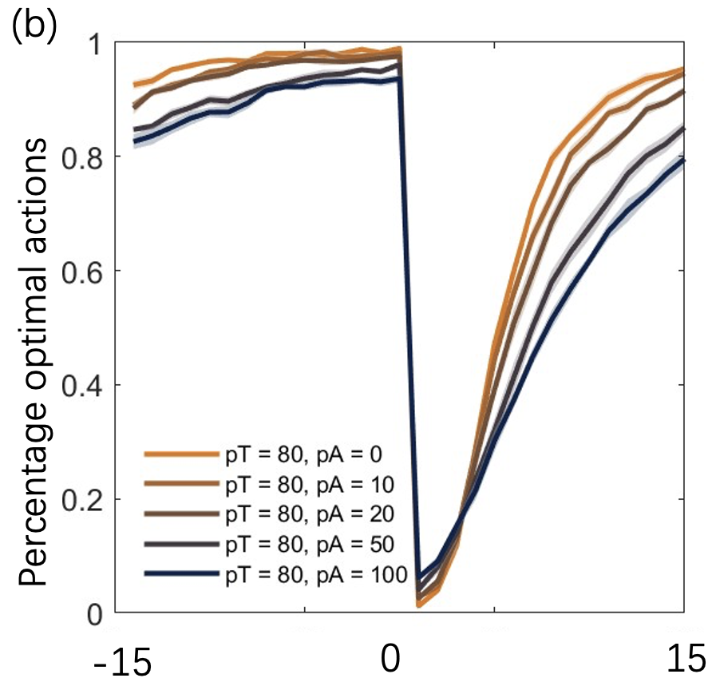
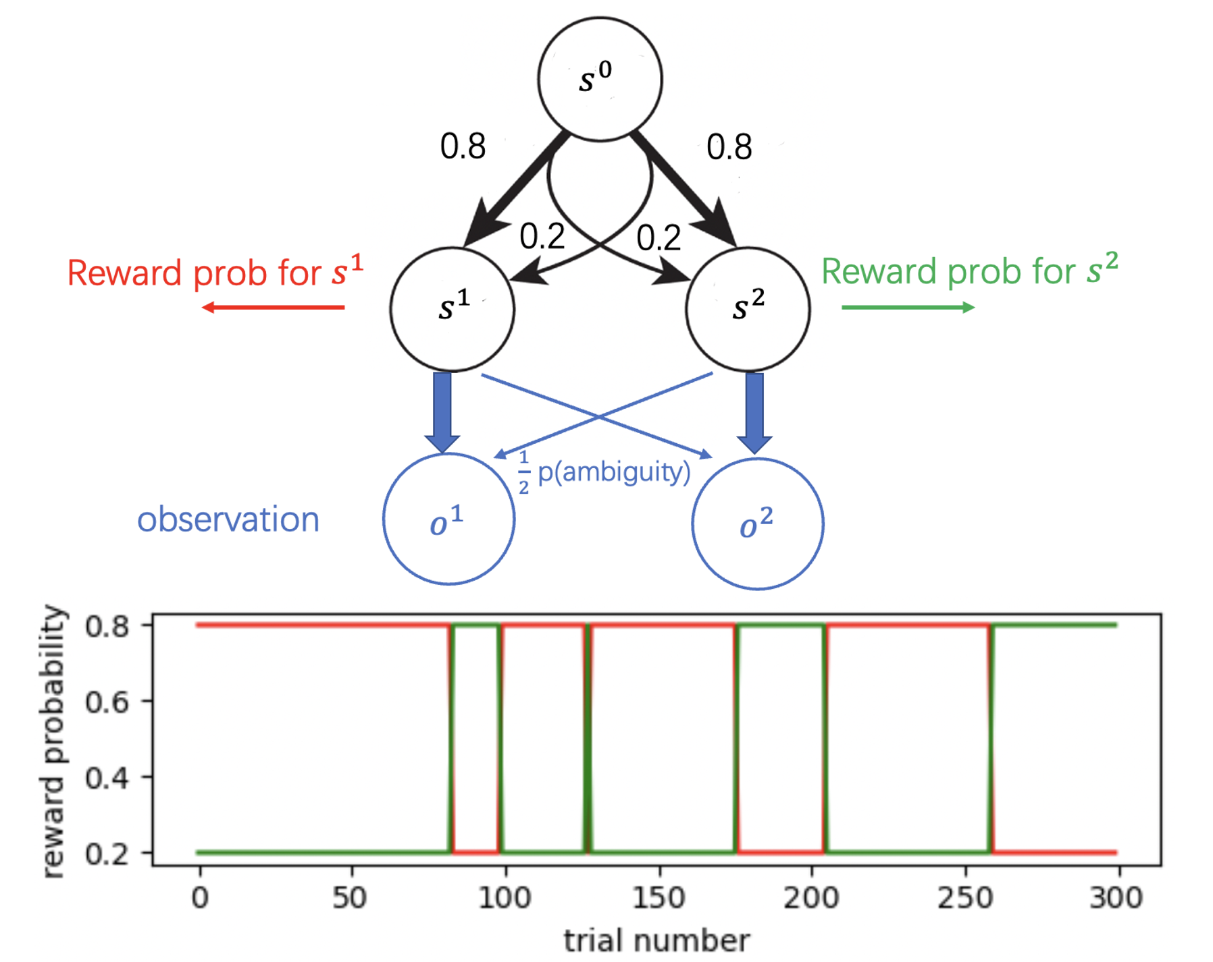
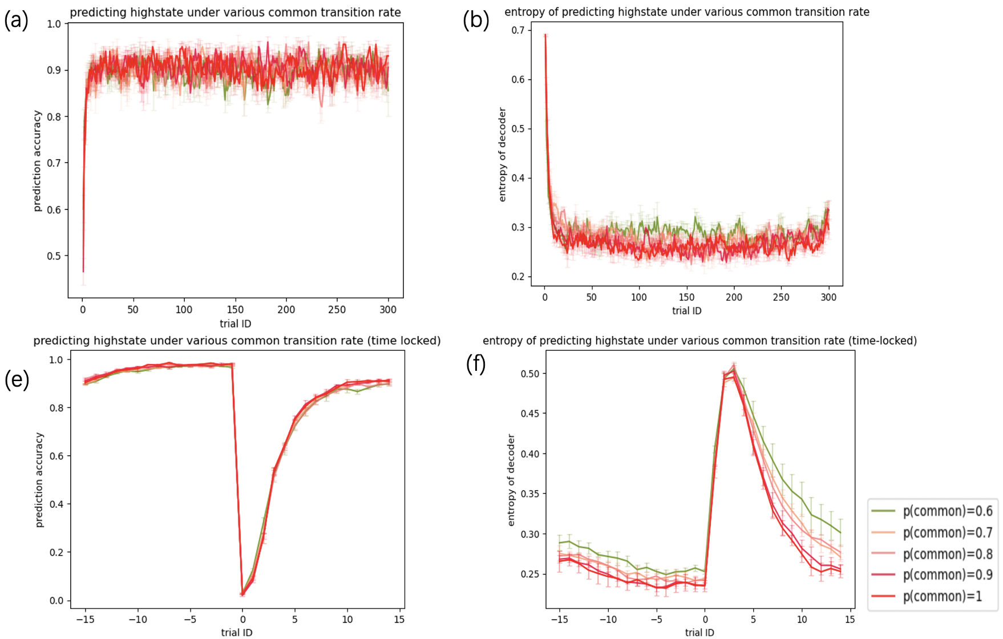
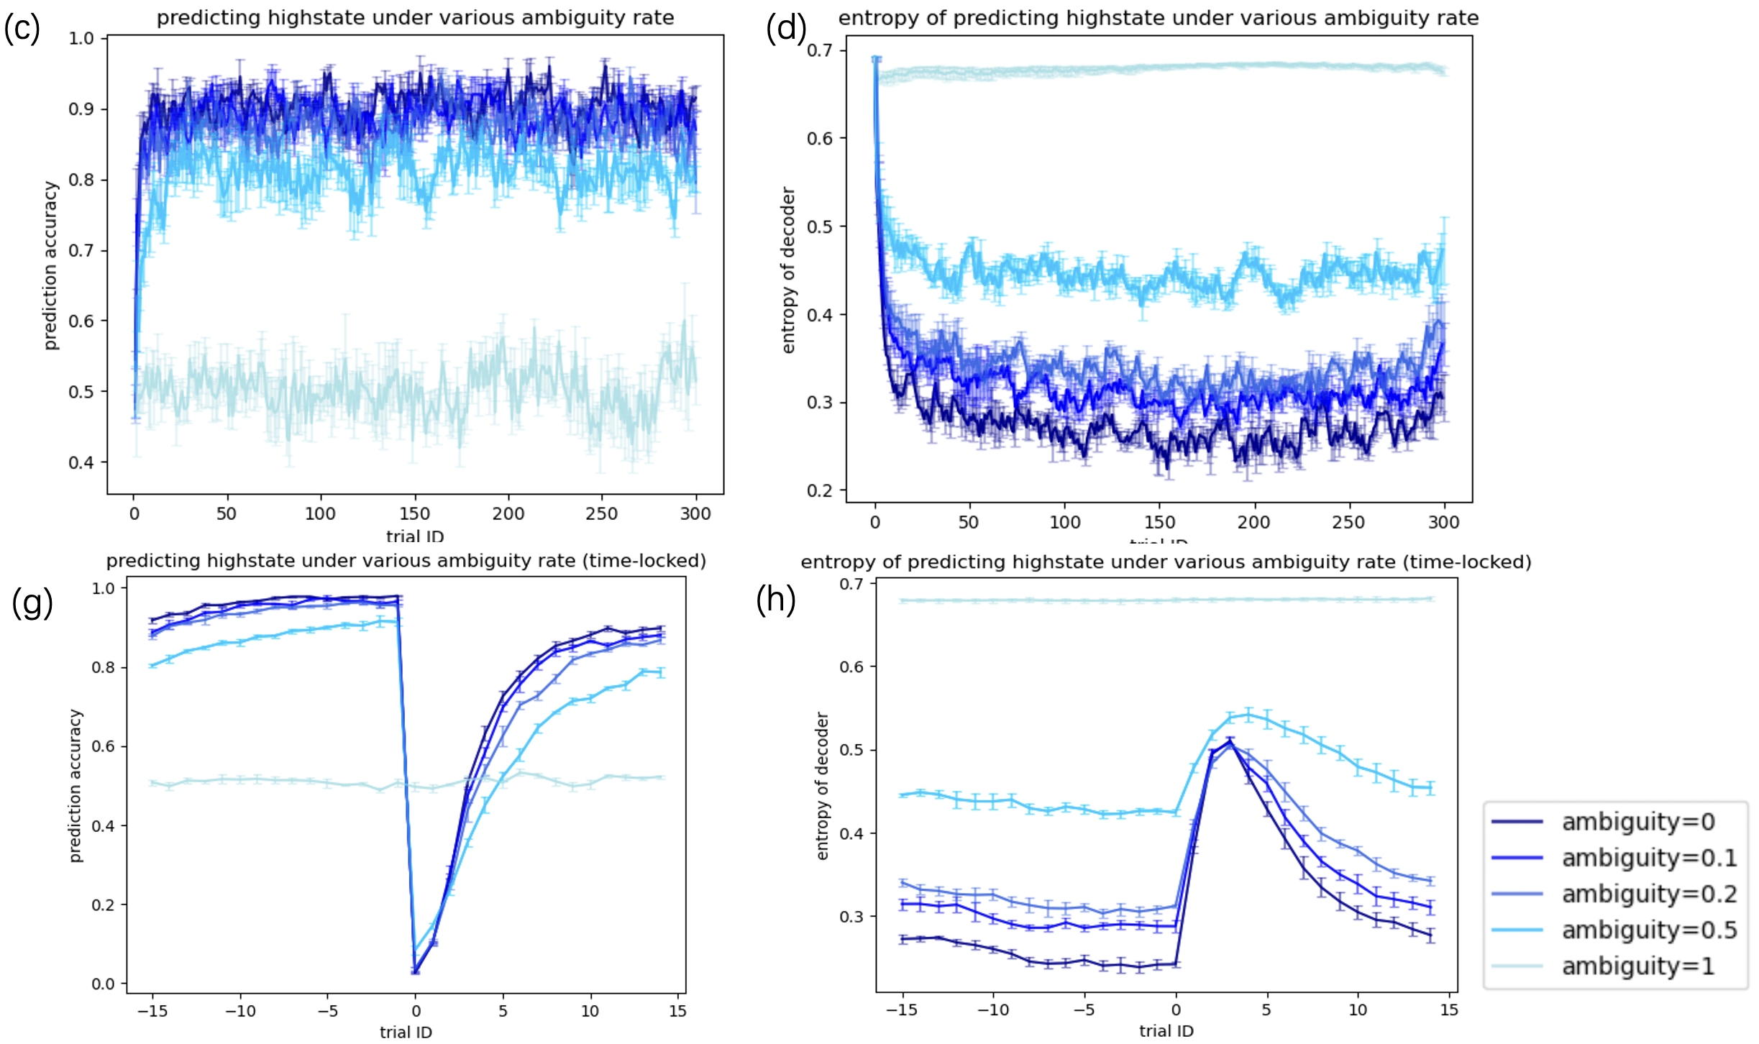
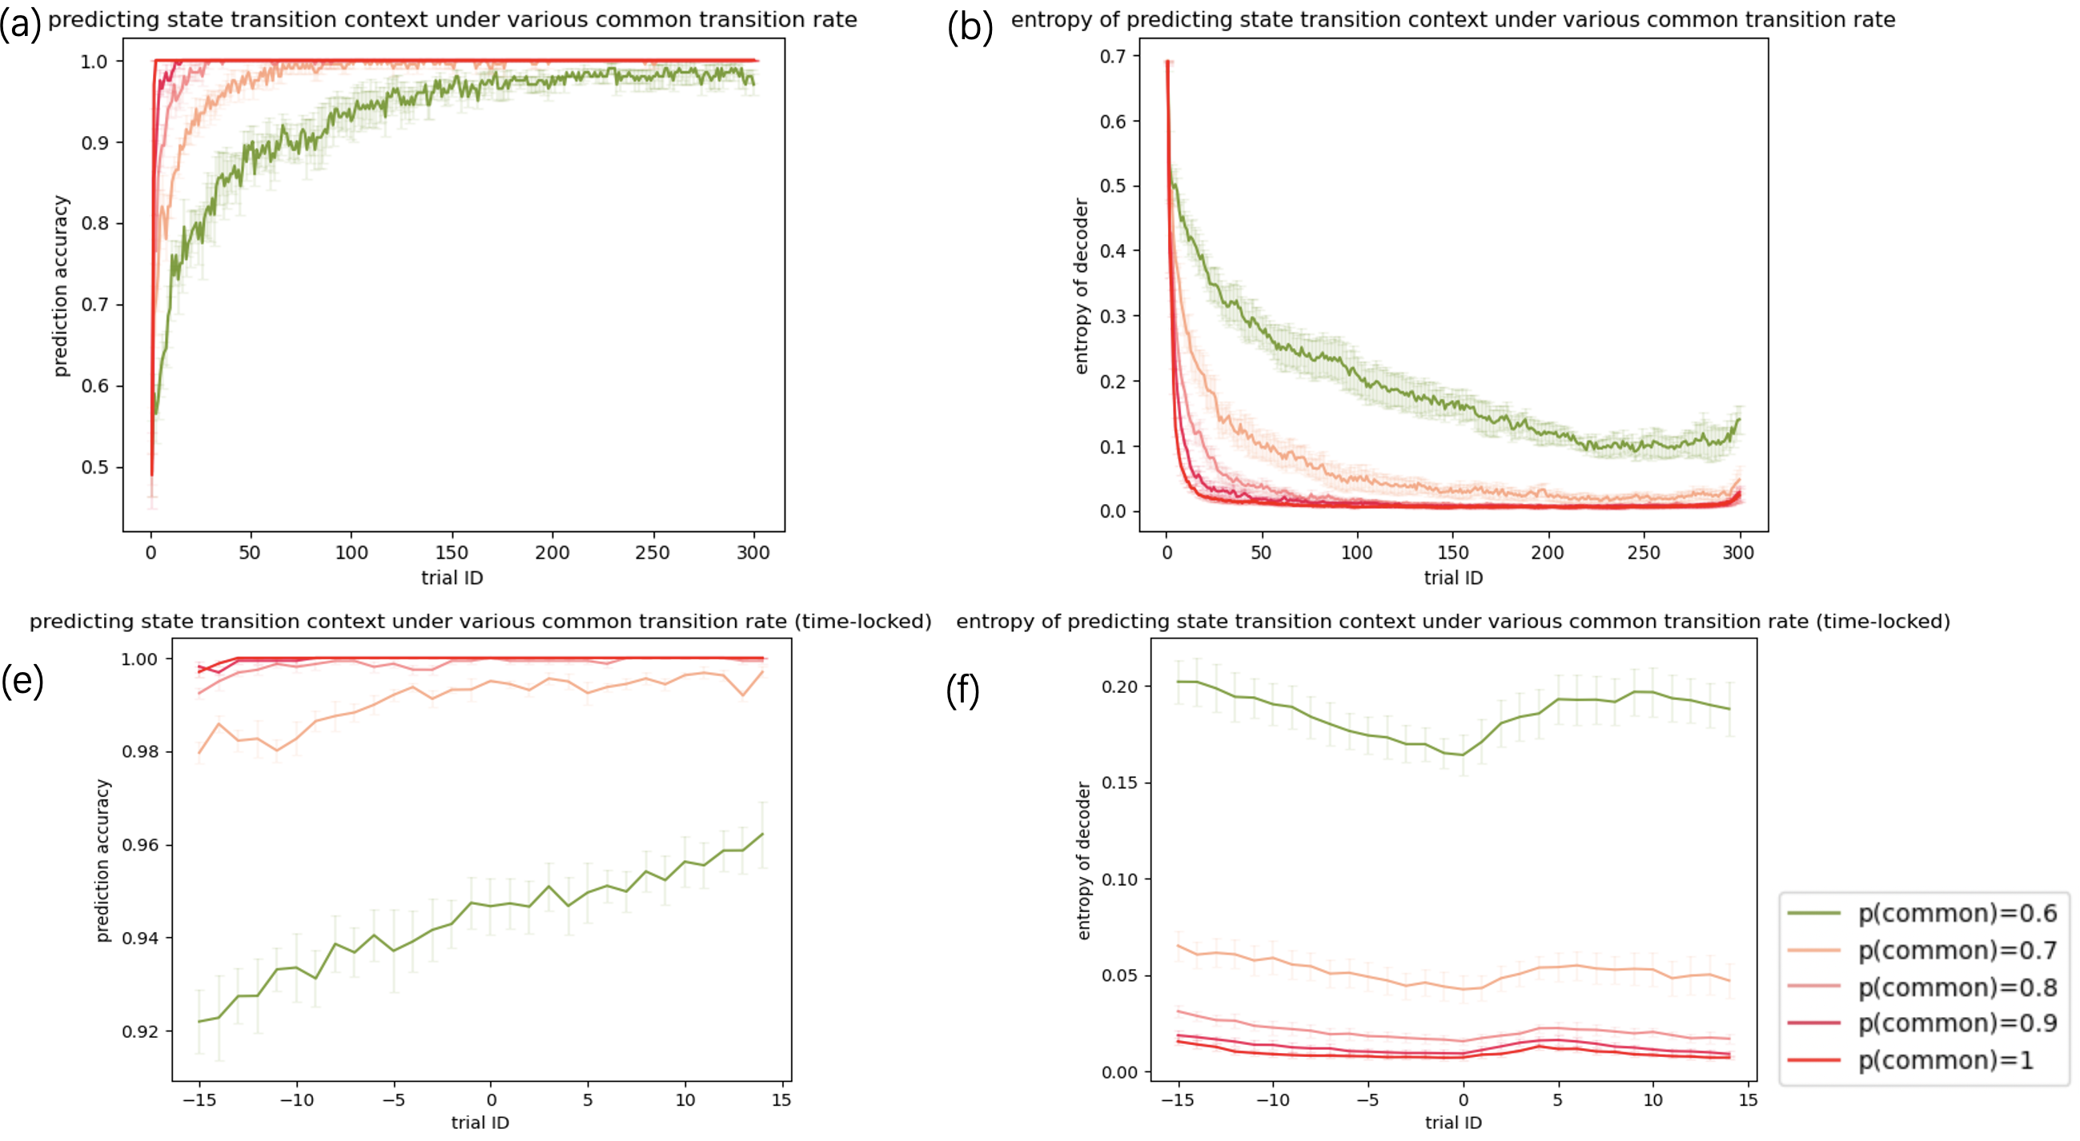
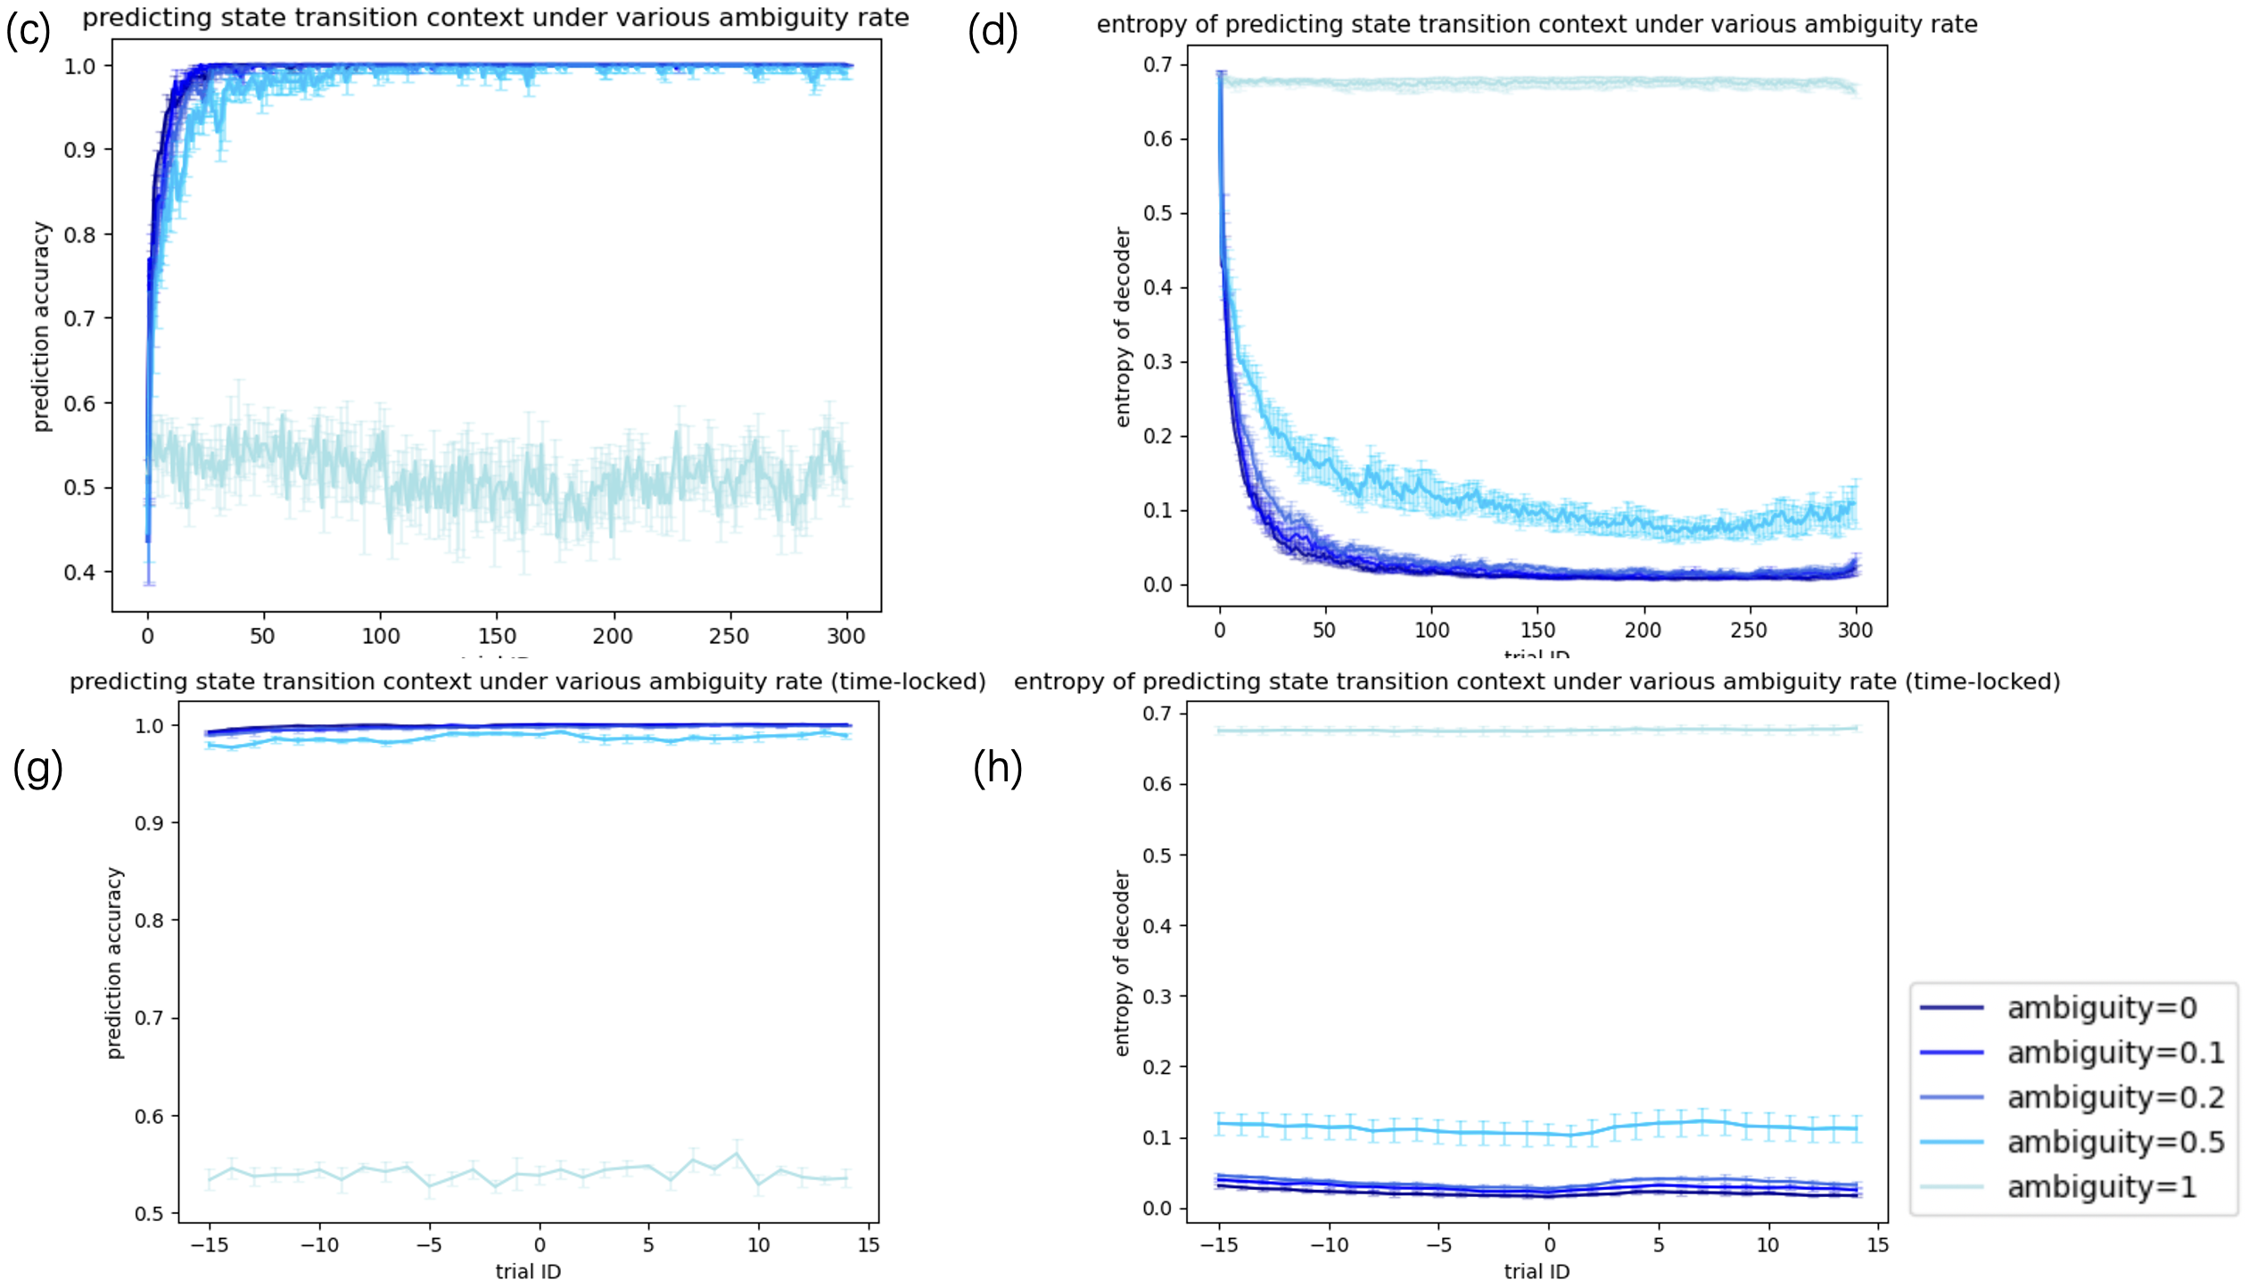

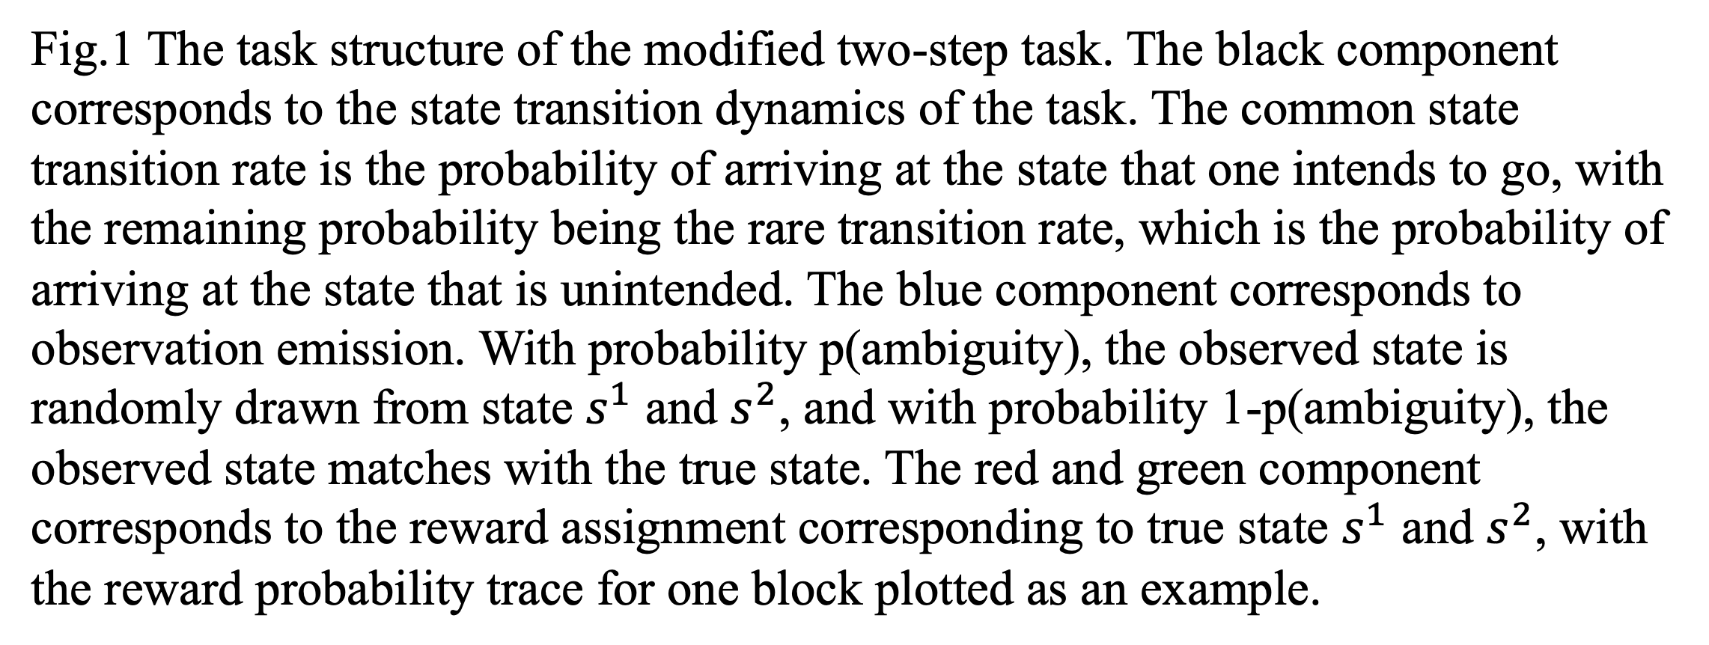
The role of model uncertainty in the arbitration between model-based and model-free reinforcement learning Jiachen Liu* and Siyu Wang** *Neuroscience and Cognitive Science, University of Maryland, College Park **Laboratory of Neuropsychology, NIH
Abstract
Results
Humans and animals sometimes build models of the world to facilitate flexible behavior. In Model-based (MB) reinforcement learning, agents utilize internal predictions of the environment (e.g., estimate of state transitions) in action selection. In model-free (MF) reinforcement learning, instrumental actions are learned without using environment models. The arbitration between MB and MF systems has been studied from the perspective of a cost-benefit tradeoff between computational expenses and model flexibility. It has been suggested that when exogenous state-transition uncertainty is high, humans tend to resort to MF strategies (Kim et al., 2019). However, it is unclear how endogenous estimate of uncertainty modulates the arbitration between MB and MF systems. In this work, we investigated how artificial recurrent network agents arbitrate between MB and MF systems using a modified version of the two-step task (Akam et al., 2015). In our modified task, true environmental states are partially observable and ambiguous. Unlike in most previous variations of the two-step task in which an optimal MB agent outperforms an optimal MF agent, in our task, MF agent outperforms MB when state ambiguity is high. This allowed us to train a network model which flexibly displayed MB behavior when state ambiguity is low, and MF behavior when ambiguity is high. By examining endogenous estimates of state-transition uncertainty in the network, we explored the role of state-transition uncertainty in the arbitration between MB and MF RL.
Fig.2 Model-free and model-based agent’s performance across (a) different common transition rate with 0 ambiguity (b) different ambiguity rate with 0.8 common transition probability.
Fig.3 Network performance and data likelihood across different common transition rates. (a) percentage optimal actions of the trained neural network and (b) Likelihood of behavioral data generated by model-free and model-based agent under different common transition rates.
Fig.8 PCA of LSTM cell activities and energy landscape across different common transition conditions. (A) - (E) are the low-dimensional trajectories of average neural network activities during a block 300 trials across different common transition conditions using 20 principal components. The first 3 PCs are plotted for visualization. (G) – (K) are the corresponding energy landscape. (L) is the average energy landscape for the 50th trial in a block for visualization.
Methods
Fig.4 Network performance and data likelihood across different ambiguity rates. (a) percentage optimal actions of the trained neural network and (b) Likelihood of behavioral data generated by model-free and model-based agent under different ambiguity rates.
The experiment uses a modified two-step task design with partial observability. An actor critic framework with long-short term memory (LSTM) feature extraction layers (Wang et al., 2018) is trained to learn this task. At each time step, the reward, action and the observed arrived second stage state in the previous time step are fed into the neural network for action decision of the current time step. The data likelihood of the behavior of the trained A2C agent is computed using a model-free Q learning agent and its model-based counterpart to examine under what circumstances the A2C agent’s behavior would more resemble the behavior of a model-free vs model-based agent. A logistic regression classifier is trained to predict high-reward state and state transition context based on the hidden state activity of the LSTM cells.
LSTM cell activities were projected onto the first 20 principal components. The integral of the time derivative of the neuron activities along the direction that maximally separates ipsilateral and contralateral state transition blocks is computed to plot the energy landscape to reveal the attractor dynamics.
Fig.5 Network performance time-locked to the onset of high/low-rewarding state flip under
(a) different common transition conditions (b) different ambiguity conditions.
Fig.8 PCA of LSTM cell activities and energy landscape across different ambiguity conditions. (A) - (E) are the low-dimensional trajectories of average neural network activities during a block 300 trials across different ambiguity conditions using 20 principal components. The first 3 PCs are plotted for visualization. (G) – (K) are the corresponding energy landscape. (L) is the average energy landscape for the 50th trial in a block for visualization.
Conclusion
The results indicated that under 0.8 common transition probability, the trained neural network exhibits model-based behavior under low ambiguity conditions and switches to model-free strategy under high ambiguity conditions. Under 0 ambiguity, the neural network behavior are better fit with model-based strategies across 0.7-0.9 common transition rates, with exception at extreme ends when there is either insufficient task structure for model-based behavior to succeed or when there is insufficient task challenge resulting comparable performance between MF and MB strategies. The decoding analysis of the LSTM cell activities indicate that LSTM cells successfully encodes the information of task conditions and can successfully predict high/low-rewarding state and the ipsilateral/contralateral transition context of the current task block under non-extreme circumstances, with the entropy of decoder indicating the subjective uncertainty in its prediction. The PCA analysis indicates that the neural network has separate population activity space for ipsilateral and contralateral transition blocks and learning for high/low rewarding states is likely to happen in these two spaces accordingly. The energy landscape analysis indicates that MB and MF strategies correspond to different energy landscapes. For the MF strategy, the landscape has one single stable equilibrium point while for the MB strategy, the landscape has one unstable equilibrium point and two stable equilibrium points. Under low ambiguity conditions and high common transition conditions, the energy landscape has steeper curvature, corresponding to a higher model uncertainty for making predictions under these conditions. When model confidence is low, the network switches to model-free strategies.
Fig.6 Decoding of LSTM cell activity to predict high-rewarding state. (a) prediction accuracy under different common transition conditions and (b) the entropy of the decoder as a measure of subjective uncertainty. (c) prediction accuracy under different ambiguity conditions and (d) the corresponding entropy of decoder. (e) – (h) are the same analysis time locked to the onset of the high/low-rewarding state flip.
Acknowledgement
We thank Kushaan Gupta for providing technical assistance during the project.
Fig.1 The task structure of the modified two-step task. The black component corresponds to the state transition dynamics of the task. The common state transition rate is the probability of arriving at the state that one intends to go, with the remaining probability being the rare transition rate, which is the probability of arriving at the state that is unintended. The blue component corresponds to observation emission. With probability p(ambiguity), the observed state is randomly drawn from state $s^{1}$ and $s^{2}$, and with probability 1-p(ambiguity), the observed state matches with the true state. The red and green component corresponds to the reward assignment corresponding to true state $s^{1}$ and $s^{2}$, with the reward probability trace for one block plotted as an example.
References
Akam, T., Costa, R., & Dayan, P. (2015). Simple Plans or Sophisticated Habits? State, Transition and Learning Interactions in the Two-Step Task. PLoS Computational Biology, 11(12), 1–25. https://doi.org/10.1371/journal.pcbi.1004648
Daw, N. D., Gershman, S. J., Seymour, B., Dayan, P., & Dolan, R. J. (2011). Model-based influences on humans’ choices and striatal prediction errors. Neuron, 69(6), 1204–1215. https://doi.org/10.1016/j.neuron.2011.02.027
Kim, D., Park, G. Y., O′Doherty, J. P., & Lee, S. W. (2019). Task complexity interacts with state-space uncertainty in the arbitration between model-based and model-free learning. Nature Communications, 10(1). https://doi.org/10.1038/s41467-019-13632-1
Wang, J. X., Kurth-Nelson, Z., Kumaran, D., Tirumala, D., Soyer, H., Leibo, J. Z., Hassabis, D., & Botvinick, M. (2018). Prefrontal cortex as a meta-reinforcement learning system. Nature Neuroscience, 21(6), 860–868. https://doi.org/10.1038/s41593-018-0147-8
.
Fig.7 Decoding of LSTM cell activity to predict ipsilateral/contralateral transition context. (a) prediction accuracy under different common transition conditions and (b) the entropy of the decoder as a measure of subjective uncertainty. (c) prediction accuracy under different ambiguity conditions and (d) the corresponding entropy of decoder. (e) – (h) are the same analysis time locked to the onset of the high/low-rewarding state flip.

